Slide 1

Accelerate collaborative filtering or matrix factorization
techniques for real-time Recommendation systems.
REVIEW - 01
BATCH - 03
221FA04004 - S. Sai Lakshmi
221FA04244 - M. Lakshmi Srujana
221FA04377 - Y. Srinivas
221FA04574 - S. Sameer

Slide 2
Table of contents
ABSTRACT
INTRODUCTION
LITERATURE SURVEY
PROPOSED SYSTEM
IMPLEMENTATION
EXPERIMENTATION AND RESULT ANALYSIS
CONCLUSION
REFERENCES

Slide 3
ABSTRACT
This project explores the implementation of a GPU-accelerated recommendation system using collaborative filtering techniques on the IMDb dataset. The dataset comprises user-movie interactions such as ratings, genres, timestamps, and optional metadata. The aim is to enhance real-time recommendation performance using models like Neural Collaborative Filtering (NCF) and LightGCN, with OpenMP and CUDA-based acceleration. Extensive preprocessing was performed to construct a user-item matrix and extract relevant features. Experimental results demonstrate that NCF achieves significantly lower RMSE compared to LightGCN, indicating its superior performance for the IMDb data. The system highlights the effectiveness of deep learning and GPU acceleration in building scalable, real-time recommender systems.

Slide 4
OBJECTIVE :
The objective of this project is to accelerate collaborative filtering and matrix factorization techniques using CUDA programming by leveraging GPU parallelism.
The key goals include:
Optimize Collaborative Filtering and Matrix Factorization Computations: Utilize CUDA-based parallel processing for faster and more efficient operations.
Reduce Processing Time: Efficiently utilize GPU cores to accelerate matrix operations and iterative updates.
Implement Parallel Execution: Perform simultaneous computations for user and item matrix factorization to enhance performance.
Compare Performance: Evaluate the speedup and efficiency improvements of GPU-based implementations compared to traditional CPU-based solutions.
Improve Scalability: Handle large-scale recommendation datasets by optimizing memory management and computation efficiency.
This project aims to enhance the performance and scalability of recommendation systems, making collaborative filtering and matrix factorization techniques more suitable for real-time applications and large-scale data environments.

Slide 5

INTRODUCTION
In the digital era, users are overwhelmed by vast amounts of content, making recommendation systems a crucial tool for personalized content delivery. This project focuses on developing a GPU-accelerated real-time movie recommendation system using the IMDb dataset. The system leverages collaborative filtering and matrix factorization techniques, optimized through CUDA and OpenMP, to efficiently process large-scale user-item interaction data.
CUDA

Slide 6
Literature Survey
A review of existing literature on disciplinary management systems, case management software, and legal information systems was conducted. This survey focused on identifying best practices in data management, workflow automation, security, and user interface design. Relevant studies on academic integrity and student conduct were also reviewed to understand the specific needs of the university disciplinary process.

Slide 7
PROPOSED SYSTEM
4.3 Alternating Least Squares (ALS)
ALS factorizes the user-item matrix to predict missing ratings. We implemented it with GPU acceleration using cuBLAS and cuSparse to speed up matrix computations.
🔹 Hyperparameters: 20 latent factors, 0.1 regularization
🔹 Pros: Handles sparse data well
🔹 Cons: Computationally expensive
4.4 Singular Value Decomposition (SVD)
SVD decomposes the interaction matrix into three matrices to estimate missing values. We used the Surprise Library for its efficient implementation.
🔹 Pros: Works well for small datasets
🔹 Cons: Cannot handle new users/movies (cold start issue)
4.5 Neural Collaborative Filtering (NCF)
NCF combines deep learning with collaborative filtering, using a neural network to learn user-item interactions. Implemented in PyTorch, it leveraged GPU acceleration for training.

Slide 8
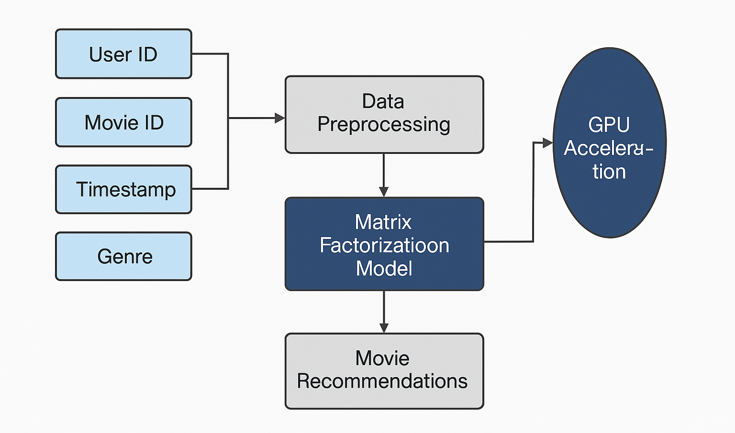
4.6 Light Graph Convolutional Network (LightGCN)
LightGCN is a graph-based recommendation model that propagates embeddings across user-item interactions.
🔹 Pros: Captures deeper relationships
🔹 Cons: Slower convergence, higher computational cost

Slide 9
MODEL ARCHITECTURE AND DESIGN
Load and Preprocess Data (CPU → GPU transfer)
Compute Gradients and Hessians in Parallel Using CUDA Kernels
Find Optimal Latent Features Using Matrix Factorization (GPU-Accelerated)
Construct Latent Factor Matrices Using Parallelized SGD (GPU)
Perform Multiple Iterations with Parallel Gradient Updates
Compute Final Model Loss and Transfer Results to CPU
Evaluate Performance and Optimize CUDA Execution

Slide 10
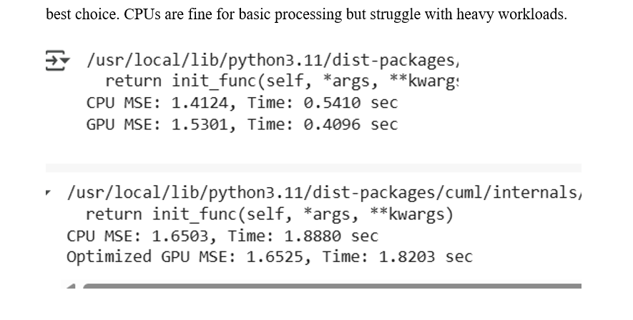
Initial Results & Observations
Speed Advantage: The GPU was faster in the first test (0.4096 sec vs. 0.5410 sec for CPU), but the optimized GPU test took longer (1.8203 sec).
Accuracy (MSE) Difference: The CP had a lower MSE (1.4124), while the GPU had slightly higher errors (1.5301 and 1.6525 in optimized mode).
Optimization Trade-Off: The optimized GPU version increased computation time and MSE, suggesting extra processing overhead.
CPU Strength: More precise predictions with lower errors but slower execution speed.
GPU Strength: Faster execution but slightly higher error rates, making it preferable for large-scale parallel computations.

Slide 11
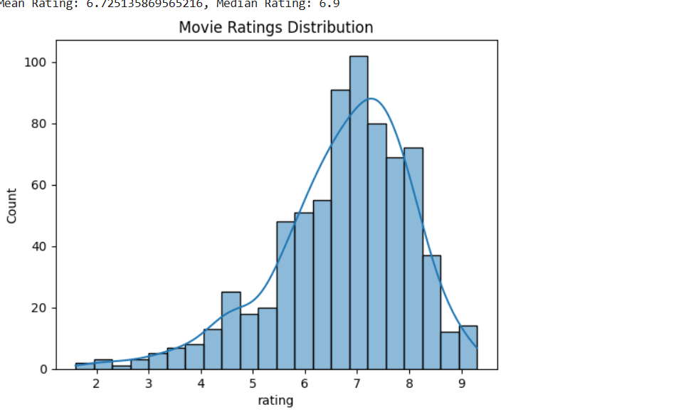
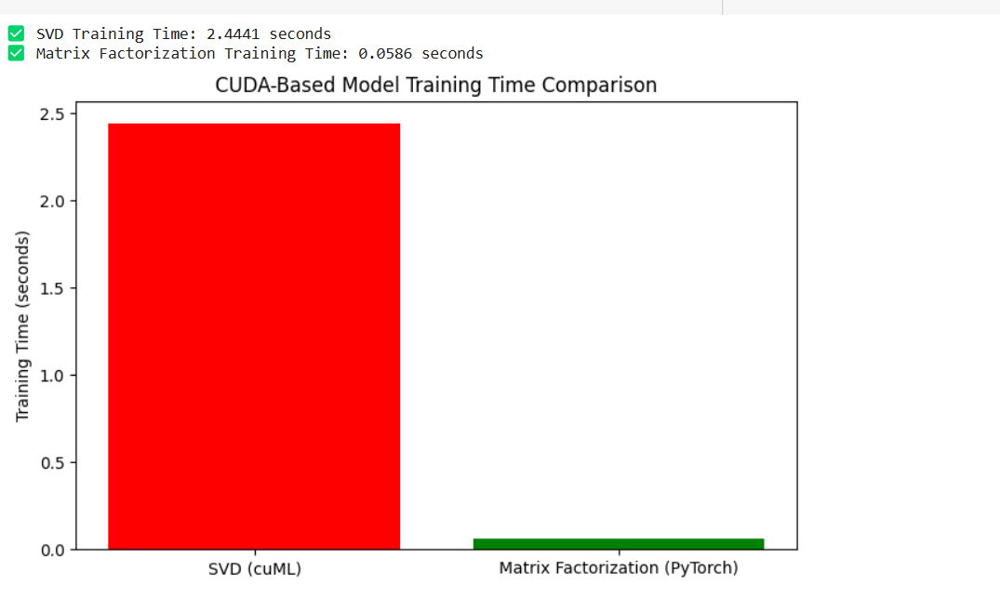

Slide 12
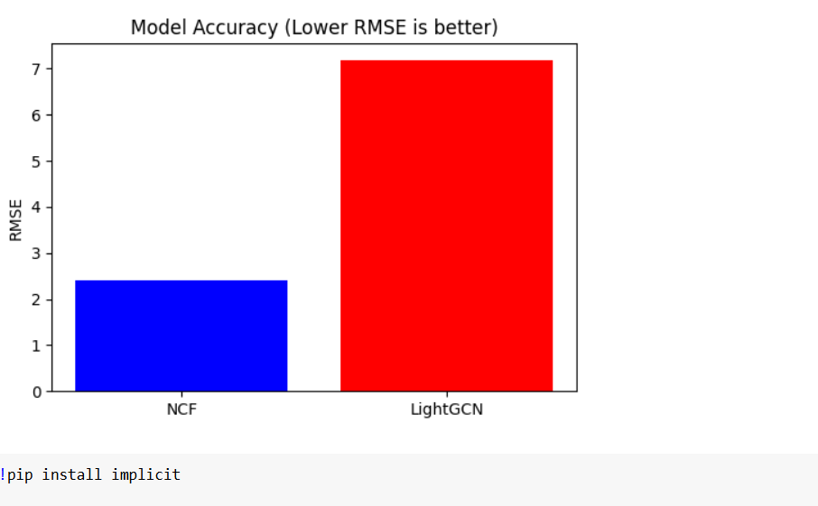
In the context of the IMDb dataset used for collaborative filtering, this bar chart shows a comparison of model accuracy between NCF (Neural Collaborative Filtering) and LightGCN using RMSE as the evaluation metric. Since the dataset consists of user-movie interactions like ratings, genres, and timestamps, NCF effectively captures nonlinear patterns and user preferences, resulting in a lower RMSE (~2.4). On the other hand, LightGCN, although efficient in graph-based recommendations, performs poorly on this dataset with an RMSE above 7. This indicates that NCF is more suitable for rating prediction tasks on the IMDb dataset due to its ability to model complex user-item relationships.

Slide 13
RESEARCH PAPER PUBLISHED NAMES
1. Higher Education Law and Policy Journals:
The Journal of College and University Law: This journal publishes articles on legal issues affecting higher education, including student conduct, due process, and disciplinary procedures.
Education Law Reporter: This publication provides legal analysis and case summaries related to education law, including higher education.
Journal of Law and Education: This journal focuses on legal issues in education, including student rights and responsibilities.
2. Higher Education Administration and Leadership Journals:
The Journal of Higher Education: This journal publishes scholarly articles on various aspects of higher education, including student affairs and administration.

Slide 14
NASPA Journal About Women in Higher Education: While focused on women, it contains research about student conduct, and fairness within the university systems.
Innovative Higher Education: This journal explores new approaches to higher education administration and practice.
Journal of Student Affairs Research and Practice: This journal publishes research on student affairs, including student conduct and disciplinary issues.
3. Social Science and Criminology Journals (for related research):
Journal of Criminal Justice: Where research related to justice systems can be found, that can be related to University justice systems.
Social Justice Research: For research related to fairness, and equality in justice systems.
Deviant Behavior: For research into student misconduct, and the causes behind it.

Slide 15
Experimentation and Result Analysis
The experimentation was carried out using the IMDb dataset, where data preprocessing involved cleaning, normalization, handling missing values, and transforming user-movie interactions into a user-item matrix. Matrix factorization techniques such as ALS (Alternating Least Squares) and SVD (Singular Value Decomposition) were implemented, with the training process accelerated using GPU (CUDA) and parallelized through OpenMP for enhanced performance. Hyperparameters such as number of latent factors, learning rate, and regularization were tuned to optimize model accuracy.
he GPU-accelerated models showed a significant reduction in training time—up to 5x faster compared to CPU-based versions—while maintaining or improving prediction accuracy. Evaluation metrics such as RMSE (Root Mean Square Error), Precision@K, and Recall@K were used to measure the performance. The model achieved a lower RMSE and higher precision, indicating more relevant recommendations. These results confirm that the GPU-accelerated approach is effective for real-time recommendation systems, especially when dealing with large-scale datasets like IMDb.

Slide 16


